Slide 1
Database System (CS-103)
DML, SQL-SELECT, Arithmetic Operation, Usage of Operators -IN, BETWEEN, LIKE, AND, OR, NOT, Aggregate Functions
Mr. Hamza Javed,
Department of Computer Science,
Muslim Youth University, Islamabad, Pakistan

Slide 2
DML- Insert Data
Syntax:
Insert into table(column1, column2, column3……… ) values(data1, data2, data3………);
Example:
insert into dblab.detail(id, name, phone, city, email) values('3', 'Ahmed', '123456', 'Islamabad', 'pak@myu.edu.pk');
Notes:
create table dblab.info(id int, name varchar(255), phone varchar(255), email varchar(255), image_name varchar(255), image_data longblob);

Slide 3
DML- Insert Images
Syntax:
Insert into table(column1, column2, column3……… ) values(data1, data2, data3………);
Example:
insert into dblab.detail(id, name, phone, city, email, image_name, image_data) values('3', 'Ahmed', '123456', 'Islamabad', 'pak@myu.edu.pk', 'myulogo', load_file('C:\\ProgramData\\MySQL\\MySQL Server 8.0\\Uploads\\logo.png’));

Slide 4
Display Table Structure
Syntax:
Describe tablename;
Example:
Describe dblab.info;

Slide 5
DQL- Select data
Syntax:
SELECT * FROM tablename;
Example:
SELECT * FROM dblab.info;

Slide 6
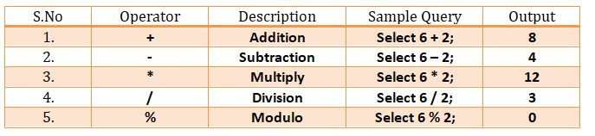
Select – Arithmetic Operator

Slide 7
Select – Arithmetic Operator (+)
Syntax:
SELECT Column1, Column2, (Column1 operator value) FROM tablename;
Example:
SELECT id, name, (age+5) FROM dblab.info;

Slide 8
Select – Arithmetic Operator (-)
Syntax:
SELECT Column1, Column2, (Column1 operator value) FROM tablename;
Example:
SELECT id, name, (age-5) FROM dblab.info;

Slide 9
Select – Arithmetic Operator (*)
Syntax:
SELECT Column1, Column2, (Column1 operator value) FROM tablename;
Example:
SELECT id, name, (age*5) FROM dblab.info;

Slide 10
Select – Arithmetic Operator (/)
Syntax:
SELECT Column1, Column2, (Column1 operator value) FROM tablename;
Example:
SELECT id, name, (age/5) FROM dblab.info;

Slide 11
Select – Arithmetic Operator (%)
Syntax:
SELECT Column1, Column2, (Column1 operator value) FROM tablename;
Example:
SELECT id, name, (age%5) FROM dblab.info;

Slide 12
Select – Arithmetic Operator (Precedence)
Syntax:
SELECT Column1, Column2, (Value operator Column1 operator value) FROM tablename;
Example:
SELECT id, name, (16 + Age * 12) FROM dblab.info;
16 + Age * 12 => 16 + 44 * 12 = 544 16 + Age / 12 => 16 + 44 / 12 = 19.66

Slide 13
Select – Arithmetic Operator (Parentheses)
Syntax:
SELECT Column1, Column2, (Value operator Column1) operator value FROM tablename;
Example:
SELECT id, name, (16 + Age) / 12) FROM dblab.info;
(16 + Age) * 12 => (16 + 44) * 12 = 720 (16 + Age) / 12 => (16 + 44) / 12 = 5.0

Slide 14
Other Arithmetic Operator
Function | Value | Result
ABS | ABS(-43.25) | 43.25
Floor | Floor(2.6) | 2
CEIL | CEIL(1.40) | 2
Round() | Round(4.51) OR Round(4.49) | 5 OR 4
SQRT(number) | SQRT(64) | 8
POW(base, exp) | POW(2,3) | 8
Sign(number) | Sign(25), sign(0), sign(-25) | 1,0,-1
Rand() | 1 + Rand() * 5 | Any value between 1-5
Notes:
SELECT round(64.345);
Select id, name, age from table order by Rand()

Slide 15
Select – Where
Syntax:
SELECT * FROM tablename where column = value;
Example:
SELECT * FROM dblab.info where id = 40;

Slide 16
Select – Change Column Name (AS)
Syntax:
SELECT Column_Name AS New_Name, Phone FROM table
Example:
SELECT Name AS Student_Name, Phone FROM sectionb.student WHERE Age = 44;

Slide 17
Select – Column Concatenation
Syntax:
SELECT concat(column1, column2) AS "Student" FROM student;
Example:
SELECT concat(id,” ”, S_Name) AS "Student" FROM student;

Slide 18
Select – Literal Character String
Syntax:
SELECT concat(column1, " string ", column2) AS "Student" FROM tablename;
Example:
SELECT concat(id, " is a ", S_Name) AS "Student" FROM student;

Slide 19
Select – Duplicate / Non-Duplicate Data
Syntax:
SELECT * FROM tablename;
OR
SELECT DISTINCT Column1, Column2, Column3 FROM tablename;
Example:
SELECT * FROM dblab.info;
OR
SELECT DISTINCT id, i_name, phone FROM sectionb.detail;

Slide 20
DML- Update Data
Syntax:
Update table Set column_name = value where column_name = value
Example:
update student Set Age = 44 where Id = 7;
Notes:
update sectionc.employee Set age = 19 where id = 2;
SET SQL_SAFE_UPDATES=0;
12:29:29 update sectionc.employee Set age = 30 where id = 2 Error Code: 1175. You are using safe update mode and you tried to update a table without a WHERE that uses a KEY column. To disable safe mode, toggle the option in Preferences -> SQL Editor and reconnect. 0.000 sec

Slide 21
DML- Delete Data
Syntax:
Delete from table where column_name = value
Example:
Delete from student where Id = 7;

Slide 22
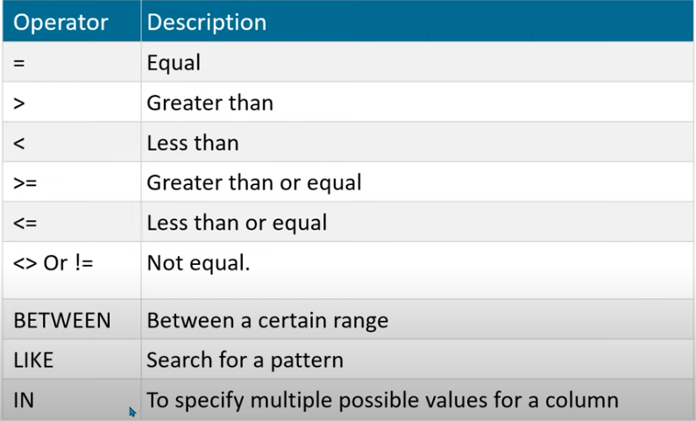
Comparison Operator

Slide 23
Logical Operator
Operator
AND OR
NOT
Meaning
Returns TRUE if both component conditions are true
Returns TRUE if either component condition is true
Returns TRUE if the following condition is false

Slide 24
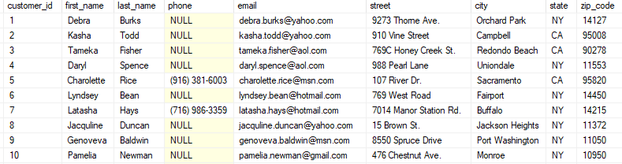
Example
Create new table as example and store 10-15 rows of data to perform above comparison operation

Slide 25
Select- equal to
Syntax:
Select first_name, last_name from table where column_name = value
Example:
Select first_name AS name, City As Address from customer where Zip_code = 1427;

Slide 26
Select- Not equal to
Syntax:
Select first_name, last_name from table where column_name != value
Example:
Select S_Name AS Cutomer, Gender, Age As Sex from sectionb.student where Age != 48;
Name | Age | Gender | DOB
Ali | 26 | Male | 1999
Ayesha | 40 | Female | 1986
Uzair | 48 | Male | 1974
Customer | Sex | Gender
Ali | 26 | Male
Ayesha | 40 | Female

Slide 27
Select- less then & greater then
Syntax:
Select first_name, last_name from table where column_name < value
Select first_name, last_name from table where column_name > value
Example:
Select S_Name AS Cutomer, Gender As Sex from sectionb.student where Age < 44;
Select S_Name AS Cutomer, Gender As Sex from sectionb.student where Age > 28;

Slide 28
Select- less then equal to & greater then equal to
Syntax:
Select first_name, last_name from table where column_name <= value
Select first_name, last_name from table where column_name >= value
Example:
Select S_Name AS Cutomer, Gender As Sex from sectionb.student where Age < = 28;
Select S_Name AS Cutomer, Gender As Sex from sectionb.student where Age >= 44;

Slide 29
Select- AND
Syntax:
Select column1, column2 from table where column_name = value AND column = value
Example:
SELECT Name, Phone FROM student4 WHERE Age <= 44 AND Gender = ‘Male’;

Slide 30
Select- OR
Syntax:
Select column1, column2 from table where column_name = value OR column = value
Example:
SELECT Name, Phone FROM student4 WHERE Age <= 44 OR Gender = 'Male’;

Slide 31
Select- NOT
Syntax:
Select column1, column2 from table where NOT column_name = value
Example:
SELECT Name, Phone FROM sectionb.student4 WHERE NOT Age = 44;

Slide 32
Select- Between
Syntax:
Select column1, column2 from table where column_name between value and value
Example:
Select S_Name AS Cutomer, Gender As Sex from sectionb.student where where Age between 25 and 44;
Name | Age | Gender | DOB
Ali | 26 | Male | 1999
Ahmed | 75 | Male | 1951
Ayesha | 40 | Female | 1986
Uzair | 48 | Male | 1974
Name | Age | Gender | DOB
Ali | 26 | Male | 1999
Ayesha | 40 | Female | 1986

Slide 33
Select- Not Between
Syntax:
Select column1, column2 from table where column_name Not between value
AND Value
Example:
Select S_Name AS Cutomer, Gender As Sex from sectionb.student where where Age Not between 25 and 44;
Name | Age | Gender | DOB
Ali | 26 | Male | 1999
Ahmed | 75 | Male | 1951
Ayesha | 40 | Female | 1986
Uzair | 48 | Male | 1974
Name | Age | Gender | DOB
Ahmed | 75 | Male | 1951
Uzair | 48 | Male | 1974

Slide 34
Select – Like and Wild Card Character
Syntax:
Select column1, column2 from table where like 'A%'
Example:
Select * from student where Name like 'U%'
Name | Age | Gender | DOB
Ali | 26 | Male | 1999
Ahmed | 75 | Male | 1951
Ayesha | 40 | Female | 1986
Uzair | 48 | Male | 1974
Where Name like “U%”
Name | Age | Gender | DOB
Uzair | 48 | Male | 1974

Slide 35
Select – Wild Card Character
Wild Card Character:
Percentage %: Represent zero, one or multiple character
Underscore _: Represent a single character
Pattern | Description
Like 'a%' | Start with a
Like '%a' | End with a
Like '%am%' | Have “am” at any position
Like 'a%m' | Start with ‘a’ and end with ‘m’
Like '_a%' | a in second position
Like '__a%' | a in third position
Like '__ab' | a in second position and b in third position

Slide 36
Select – Not like
Syntax:
Select column1, column2 from table where Not like 'A%'
Example:
Select * from student where Name Not like 'U%'

Slide 37
Select- IN / Not IN
Syntax:
Select column1, column2 from table where ColumnName IN (Value1, Value2, Value3)
Example:
Select Name, age from table where Age IN (10, 20, 30)
Syntax:
Select column1, column2 from table where ColumnName NOT IN (Value1, Value2, Value3)
Example:
Select Name, age from table where Age NOT IN (10, 20, 30)

